Slide 1
SS ZG653 (RL 14): Software Architecture Design Pattern
Instructor: Prof. Santonu Sarkar
March 17, 2015

Slide 2
Design Patterns
A Pattern presents a proven advice in standard format
A design pattern gives advice about a problem in software design.
Attributes of design Pattern:
1. Name [name of the design pattern]
2. Context [situation where it can be applied]
3. Problem [The exact problem to be solved]
4. Solution [The solution outline in the form of class diagram ]

Slide 3
Pattern Classification
 | Architectural Patterns | Design Patterns | Idioms
Mud to Structure | Layers, Pipes and Filters, Blackboard
Distributed Systems | Broker, Pipes and Filters, Microkernel
Interactive Systems | MVC, PAC
Adaptable Systems | Microkernel, Reflection
Creation |  | Abstract Factory, Prototype, Builder | Singleton, Factory Method
Structural Decomposition |  | Whole-Part, Composite
Organisation of work |  | Master-Slave, Chain of Responsibility, Command, Mediator
Access Control |  | Proxy, Façade, Iterator
Service Variation |  | Bridge, Strategy, State | Template method
Service Extension |  | Decorator, Visitor
Management |  | Command Processor, View Handler, Memento
Adaptation |  | Adapter
Communication |  | Publisher-subscriber, Forwarder-Receiver, Client-Dispatcher-Server
Resource Handling |  | Flyweight | Counted Pointer

Slide 4
From GoF classification
Creational | Factory Pattern | About creation
 | Factory Method | About creation, also called Idioms
 | Singleton
Structural | Adapter | About structural decomposition
 | Composite
 | Decorator | About service extension
 | Proxy | About access control
Behavioral | Iterator
 | Observer | Communication
 | Visitor | About service extension
 | Strategy | Service variation
 | Command | Organization of task

Slide 5
What is Creational Pattern?
Provides mechanisms to create objects in a more generic manner
Direct object creation sometimes can make the application susceptible to frequent changes.
Creational pattern is a more indirect way of object creation
Provide different ways (patterns) to remove explicit references in the concrete classes from the code that needs to instantiate them.

Slide 6
Why Creational Patterns?
A system should be independent of how its objects and products are created.
Hiding the implementations of a class library or product, revealing only their interfaces.
Creating different representation of independent complex objects shouldn’t have change impact
A class wants its subclass to implement the object it creates.
The class instantiations are specified at run-time.
There must be a single instance and client can access this instance at all times.
Instance should be extensible without modifying the code.

Slide 7
Three Creational Patterns
Factory method pattern
A method that creates a type of object
Centralize the creation of objects
Factory Pattern
Centralize the decision of what factory (the class which actually creates the business object) to instantiate
Singleton
Restricts instantiation of only object for a business logic class

Slide 8
The FACTORY METHOD Pattern
Context
A type (the creator) creates objects of another type (the product).
Subclasses of the creator type need to create different kinds of product objects.
Clients do not need to know the exact type of product objects.
Solution
Define an (abstract) creator type that contains main logic of handling an abstract product.
Define an abstract method, called the factory method, in the creator type. The factory method yields a product object.
Each concrete creator class implements the factory method so that it returns an object of a concrete product class.
Define an (abstract) product type that models a common product
Create concrete products

Slide 9
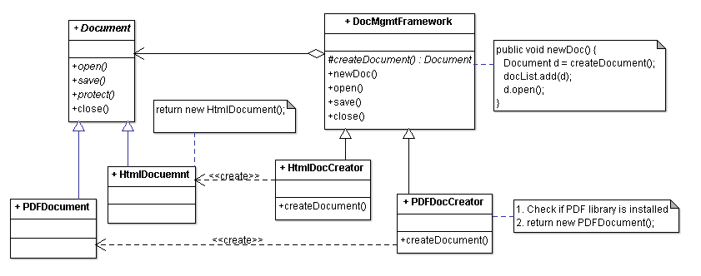
Factory Method Pattern
DocumentMgmtFramework
knows when to create a Document (when user selects the menu item
but DOES NOT anticipate what type of Document to create

Slide 10
Factory Method Pattern Example
Framework classes are all abstract and it does not change when new document types are added
DocumentMgmtFramework can also provide a default creation of a Document
Client provides new types of documents and document creation factory.
Later on you can add another type of document w/o changing DocumentMgmtFramework

Slide 11
Benefits
Introduces a separation between the application and a family of classes
Weak coupling instead of tight coupling hiding concrete classes from the application framework
Simple way of extending the family of products with minor changes in application code
It provides customization hooks

Slide 12
Abstract Factory Pattern
Context
Instead of one product, there could be multiple families of products which needs to be instantiated
System needs to be independent from the way the products it works with are created
Solution
Create a factory to instantiate objects specific to a particular family of products
One factory per product family

Slide 13
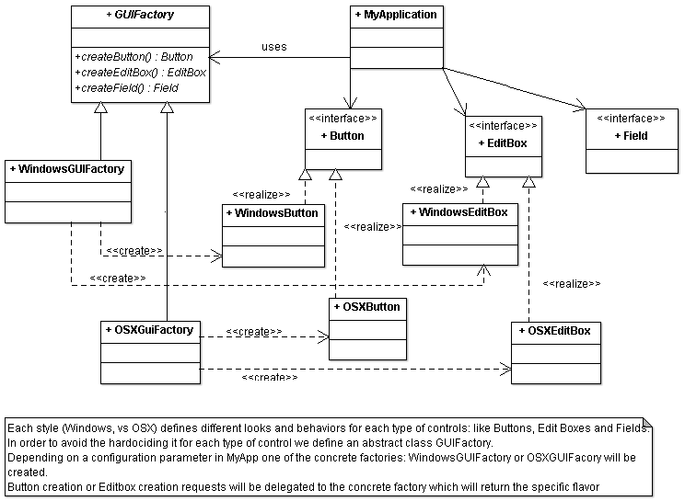
Abstract Factory Pattern

Slide 14
Creational Patterns and Reflection
Many of the object- oriented design patterns can benefit from reflection
Reflection extends the decoupling of objects that design patterns offer
Can significantly simplify design patterns
Factory
Factory Method
One can either create different factory method class for each type of object OR
Create a nested if-then-else to create all possible types of object.

Slide 15
Factory Method Without Reflection
public static Document createDocument(String s) {
Document temp = null;
if (s.equals (“Html”))
temp = new HtmlDocument();
else if (s.equals (“PDF”))
temp = new PDFDocument();
else // …
// continues for each kind of shape
return temp;
}

Slide 16
Factory With Reflection
public static Shape getFactoryShape (String s) {
Shape temp = null;
try
{
temp=(Shape) Class.forName(s).
newInstance();
}
catch (Exception e) {
}
return temp;
}

Slide 17
Singleton Pattern
Sometimes it's important to have only one instance for a class
For example, in a system there should be only one window manager (or only a file system or only a server object).
Usually singletons are used for centralized management of internal or external resources and
Provide a global point of access

Slide 18
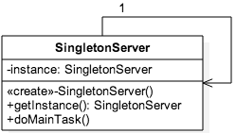
Singleton Example
SingletonServer.getInstance()
.doMainTask();
A static member in the Singleton class
A private constructor
The constructor should not be accessible from the outside of the class to ensure the only way of instantiating the class would be only through getInstance()
A static public method that returns a reference to the static member
getInstance() method is used also to provide a global point of access to the object
public static SingletonServer getInstance() {
if (instance==null)
instance= new SingletonServer();
return instance;
}

Slide 19
Applicability Example
Logger Class
A logger is usualy implemented as a singletons, and provides a global logging access point in all the application components without being necessary to create an object each time a logging operations is performed.
Configuration Classes
Provides the configuration settings for an application
Not only a global access point, but one can keep the instance as a read-only cache object
Server object

Slide 20
Thank You

